Slide 1


Understanding Unimodal Bias in Multimodal Deep Linear Networks
GeWu-Lab Laboratory Intern Application Interviews
杨凯冰
2025.1.3-1.7

Slide 2


00
Information
Name: Understanding Unimodal Bias in Multimodal Deep Linear Networks
Author: Yedi Zhang ,Peter E. Latham , Andrew Saxe
Address: Gatsby Computational Neuroscience Unit
University College London 2 Sainsbury Wellcome Centre
University College London
Publication: 41st International Conference on Machine Learning, PMLR 235, 2024

Slide 3
01
Introduction
Some multimodal networks overly rely on a faster-to-learn or easier-to-learn modality and ignore the others during joint training
Definition
Why?
Unimodal bias
Greedy learning
Modality competition
Modality laziness
Modality underutilization
Only empirical work but not theoretical work
There is scarce theoretical understanding of how unimodal bias is affected by the network configuration, dataset statistics, and initialization.
Regarding datasets,practitioners managed to alleviate the bias by building more balanced multimodal datasets
Example
Visual Question Answering models
Regarding multimodal network architectures, empirical work has shown that unimodal bias emerges in jointly trained late fusion networks and intermediate fusion networks while early fusion networks may encourage usage of all input modalities
tend to overly rely on the language modality
ignore the visual modality

Slide 4
01
Introduction
Work
A theoretical explanation for why unimodal bias is conspicuous in late and intermediate fusion linear networks but not in early fusion linear networks.
Calculate the duration of the unimodal phase in multimodal learning with late and intermediate fusion linear networks, as a function of the network configuration, correlation matrices of the dataset, and initialization scale.
Analyze the mis-attribution during the unimodal phase and the superficial modality preference.
Reveal that long unimodal phases lead to a generalization deficit and permanent unimodal bias in the overparameterized regime.
Generalization: We validate our findings with numerical simulations of multimodal deep linear networks and certain nonlinear networks.

Slide 5
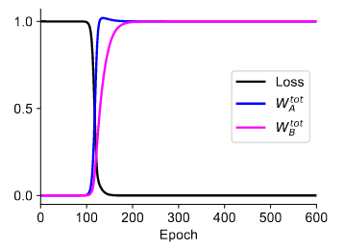
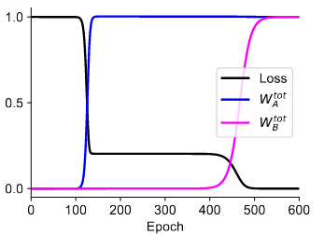
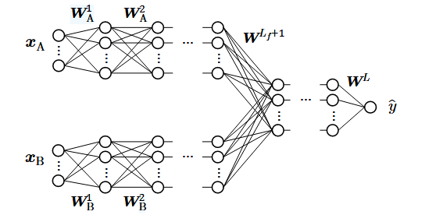
01
Introduction
Overall writing framework
Loss Landscape
Data
Network
Gradient
Early
Late
Duration of the Unimodal Phase
Problem setup
Two-layers network
Mis-attribution in the Unimodal Phase
Superficial Modality Preference
Underparameterization and Overparameterization
Early
Loss Landscape
Deep Multimodal Linear Networks
Intermediate
Duration of the Unimodal Phase
Late
Linear Task: two-layer ReLu network
Application
Realistic Task: Noisy MNIST classification
Heterogeneous Task:

Slide 6
02
Problem setup
Notation of Symbols
Data
Fusion
Linear
Network
:Weight parameter collectively
:input-output map
:A modality map
:B modality map
Gradient
Descent Dynamics
Mean square error:
Equation:
The network is initialized with small random weights.
More derivations can be found in the Appendix

Slide 7
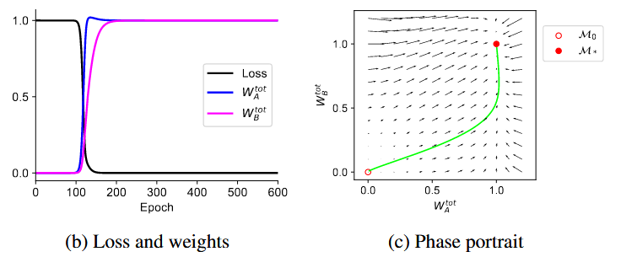
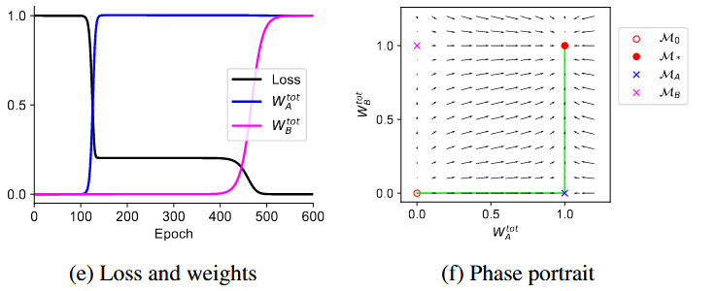
03
Two-Layer Multimodal Linear Networks
Loss Landscape
Early
Gradient descent dynamic
Late
Set the gradient to zero
Note: Two-Layer Multimodal Linear Networks only
have early fusion network and late fusion network

Slide 8
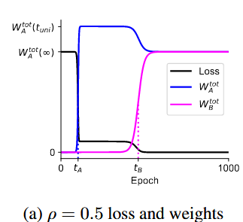
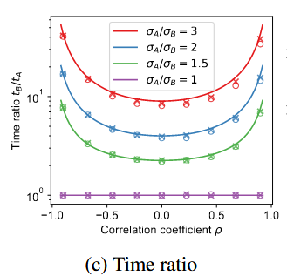
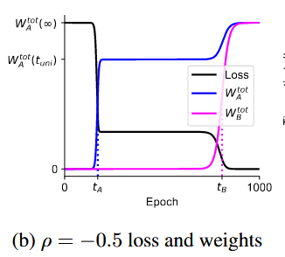
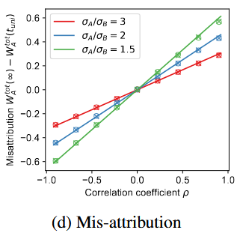
03
Two-Layer Multimodal Linear Networks
Duration of the Unimodal Phase
Early
reaches half of its associated plateau
Time ratio
Late
Assumption:
learned modality A first
small random initialization
notate the L2 norm of a vector or the
Frobenius norm of a matrix
Note: The derivation process uses the balance property
More derivation details can be found in the appendix

Slide 9
03
Two-Layer Multimodal Linear Networks
Balance property
Keyword Explanation
Between pre-fusion layers and between post-fusion
layers the standard balancing property:
Between a pre-fusion layer and a post-fusion layer, the balancing condition takes a slightly different form
Focuse on the balance of weights at the fusion point
Focuse on the balance of weights at the same type of level
Frobenius norm
Frobenius norm in the network
Properties:
Therefore
More detail about the balance property can be found in the reference

Slide 10
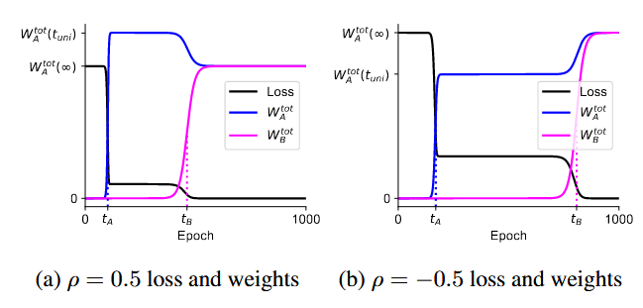
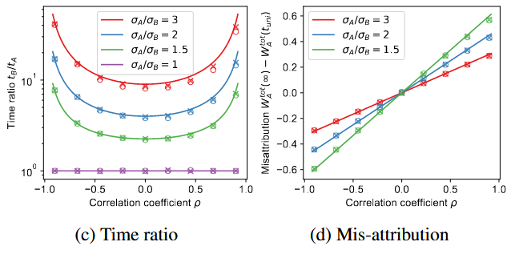
03
Two-Layer Multimodal Linear Networks
Mis-attribution in the Unimodal Phase
Late fusion network
(only occurs in the late fusion network as it learn asynchronously)
During the unimodal phase,
fits the output as much as it can and the network mis-attributes some of the output contributed by modality B to modality A
by exploiting their correlations.
Result:
the local pseudo-inverse solution differs from the
global pseudo-inverse solution
Overshoot with a positive correlation before
Undershoot with a negative correlation before
However, coverage to the global pseudo-inverse
solution eventually.
Input:
Input covariance matrix
Output:
Note: When modalities are uncorrelated, late fusion networks do not mis-attribute during the unimodal phase and behave the same as two separately trained unimodal networks

Slide 11
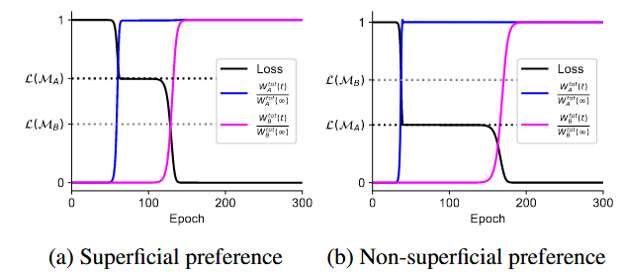
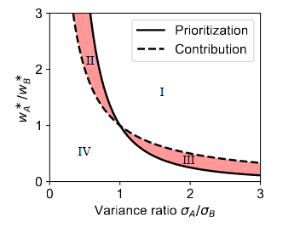
03
Two-Layer Multimodal Linear Networks
Superficial Modality Preference
Late fusion network
(only occurs in the late fusion network as it learn asynchronously)
Prioritize the modality that is faster to learn, which is not necessarily the modality that yields the
larger decrease in loss.
Solely depends on the relative size of
Learn the modality with higher correlation with the output instead with a larger contribution
Learn modality A first
Region III satisfy the equation
Region III satisfy the
flipped inequality signs
Input:
Modality B contributes more to the output
Output:
Note: When are scalars and uncorrelated, the two inequality reduce to
Networks eventually converge to zero loss, regardless of which modality is learned first and how long
the unimodal phase is

Slide 12
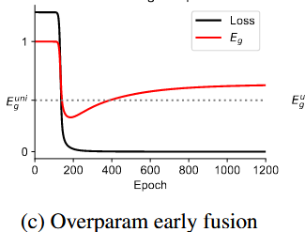
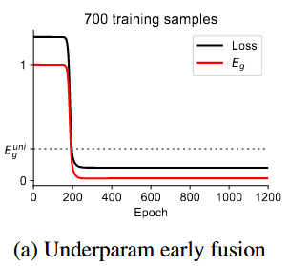
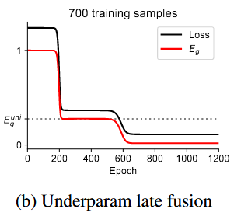
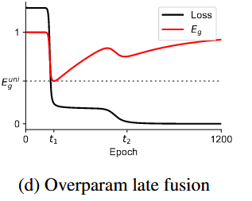
03
Two-Layer Multimodal Linear Networks
Underparameterization and Overparameterization
Underparameterization
Overparameterization
Training loss closely tracks the corresponding generalization error
The overparameterized early fusion
linear network learns both modalities
during one transition stage.
The model is relatively simple and the training data is sufficient to portray the behavior of the model
Decreases during the
transition stage and
increases afterwards
Both early and late fusion networks achieve a lower generalization error at convergence than that of a unimodal network
Early stopping can obtain a modal learn from both modalities
without overfit
The overparameterized late fusion linear network learns the faster-to-learn modality first and overfits this modality during the unimodal phase when the training loss plateaus but the generalization error increases.
Since it is important and complex,
we will discuss it in the next slide

Slide 13
03
Two-Layer Multimodal Linear Networks
Overparameterization late fusion network
The overparameterized late fusion linear network learns the faster-to-learn modality first and overfits this modality during the unimodal phase when the training loss plateaus but the generalization error increases.
Dilemma occurs!
If optimal early stopping on the generalization error is adopted, training terminates at time
The model at time has a strong and permanent unimodal bias!
But, if training terminates at time after both modalities are learned, the network has overfit the first modality. This can result in a generalization error worse than that in early stopping or what could be achieved by its unimodal counterpart.
Overfitting converts the transient unimodal phase to a
generalization deficit and permanent unimodal bias

Slide 14
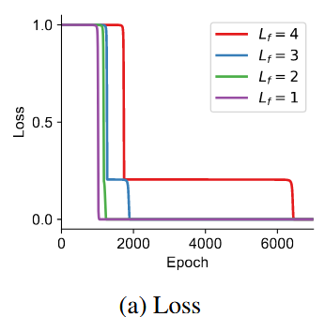
04
Deep Multimodal Linear Networks
Loss Landscape
Intermediate and Late Fusion
Early fusion network
Similar to two-layer late fusion networks
Have as well
Similar to two-layer early fusion networks
Networks with different
traverse the same plateau but they stay in the plateau for different durations.
depth slows down learning
does not qualitatively change the dynamics

Slide 15
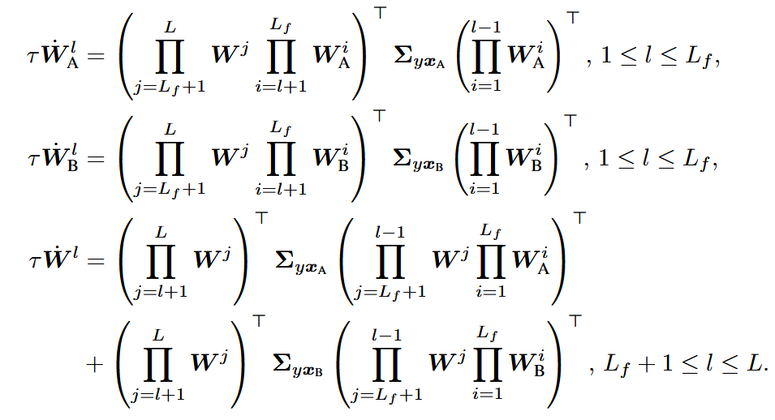
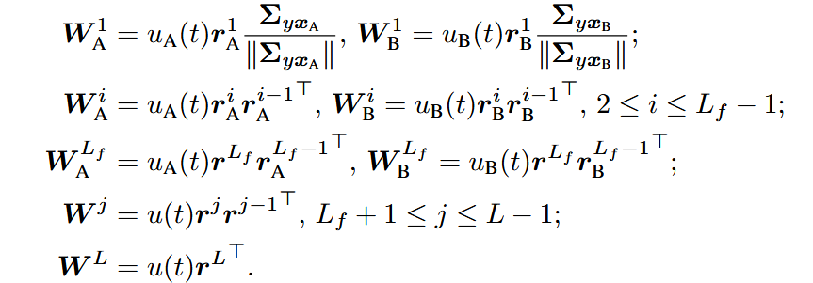
04
Deep Multimodal Linear Networks
Duration of the Unimodal Phase in the deep intermediate and late fusion linear networks
From 0 to
Then we can reduce the dynamics during time 0 to to a three-dimensional dynamical system about
Fixed unit norm column vectors
representing the freedom in
the hidden layers
Assumption:
learned modality A first
small random initialization
More detail about derivation can be found in the appendix

Slide 16
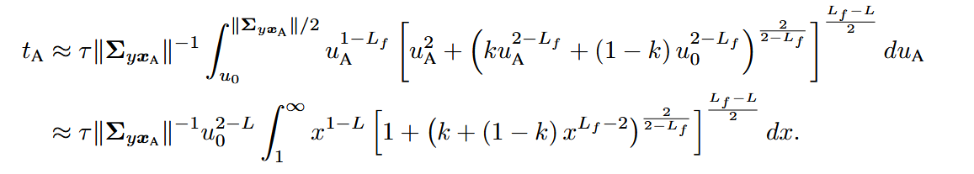
04
Deep Multimodal Linear Networks
Duration of the Unimodal Phase in the deep intermediate and late fusion linear networks
Therefore
Denote: which represents the structure
of the network
Finally
we find that the condition for modality A to be learned first in deep intermediate and late fusion linear networks is
which is the same as that for two-layer late fuison linear networks.

Slide 17
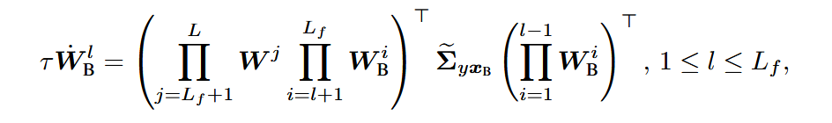
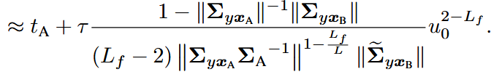
04
Deep Multimodal Linear Networks
Duration of the Unimodal Phase in the deep intermediate and late fusion linear networks
Plug$u_{A}\left(t_{A}\right),$we can get $u_{B}(t_{A})$
With small initialization and
When modality A is learned,
Therefore,
Finally
Time ratio is
More detail about derivation can be found in the appendix

Slide 18
04
Deep Multimodal Linear Networks
Duration of the Unimodal Phase in the deep intermediate and late fusion linear networks
Conclusion:
small initialization
grows
grows, which means time ratio grows with the depth
which represent Initial randomness on the training variability of
the network, will affect the time ratio
a larger input-output correlation ratio

Slide 19
04
Deep Multimodal Linear Networks
Duration of the Unimodal Phase in the deep intermediate and late fusion linear networks
Conclusion:
Time ratio in intermediate fusion network is smaller that in the late fusion network for smaller depth
From the dynamic weights equation of modality B, we can found that the shared post-fusion layer weights and the correlation between modality B and the output together drive the pre-fusion layer weights of modality B to escape from the zero fixed point.
More shared post-fusion layers
More helpful for learning the other and shorten the unimodal phase
In essence, an early fusion point allows the weaker modality to benefit from the stronger modality’s learning in the post-fusion layers.

Slide 20
04
Deep Multimodal Linear Networks
Duration of the Unimodal Phase in the deep intermediate and late fusion linear networks
Conclusion:
A deeper fusion layer
A larger input-output correlation ratio
Stronger correlations between input modalities
Sometimes a smaller initialization scale
will prolong the unimodal phase in the joint training of multimodal
deep linear networks with small initialization.

Slide 21
05
Shortcomings
Some derivations are incomplete
Part of the code is not running through

Slide 22
欢迎批评指正！

Slide 23
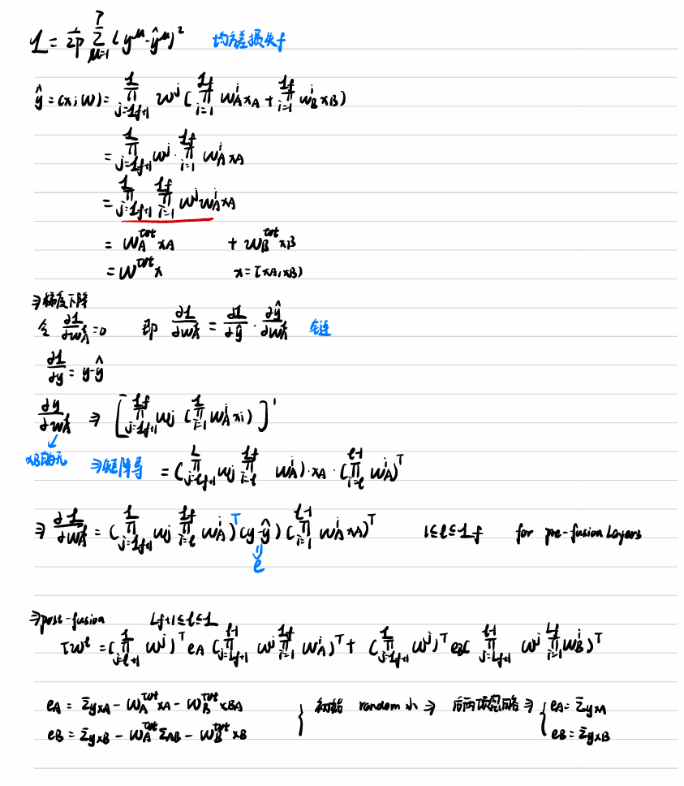
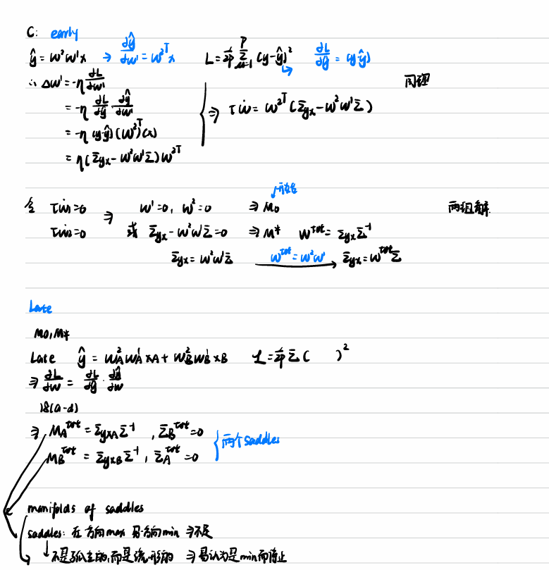
05
Appendix

Slide 24
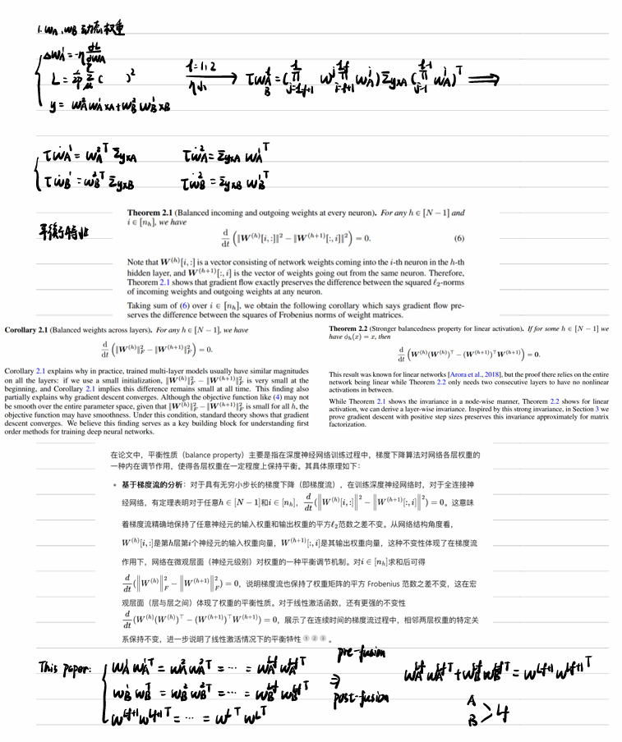
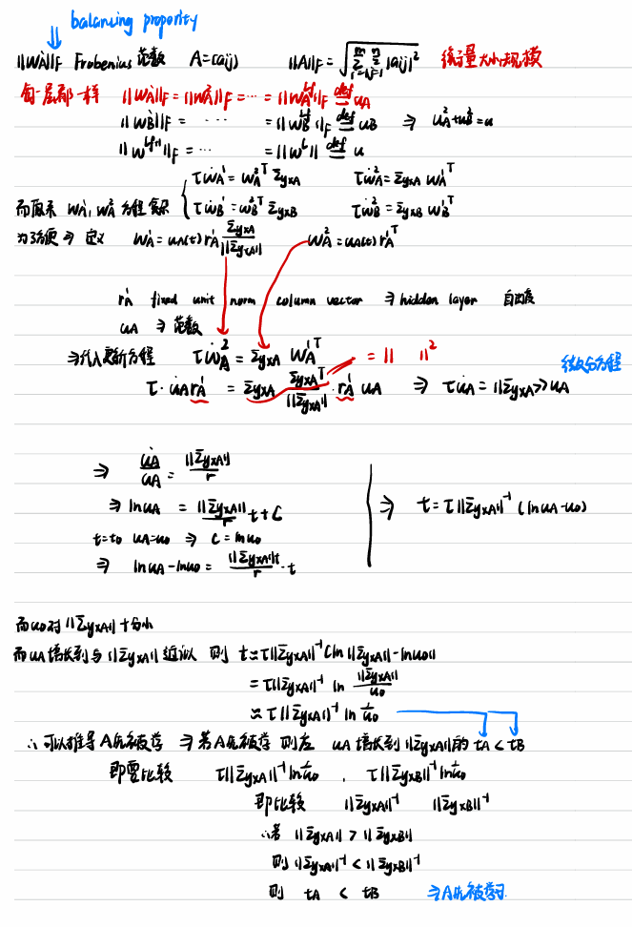
05
Appendix

Slide 25
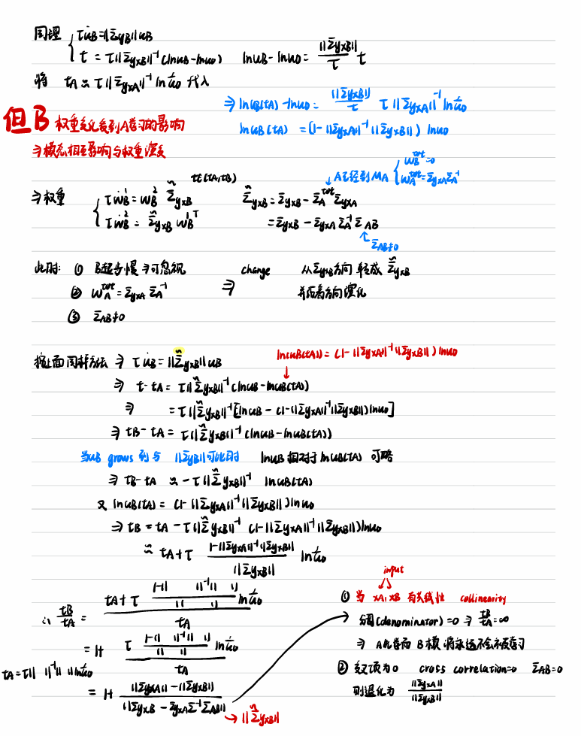
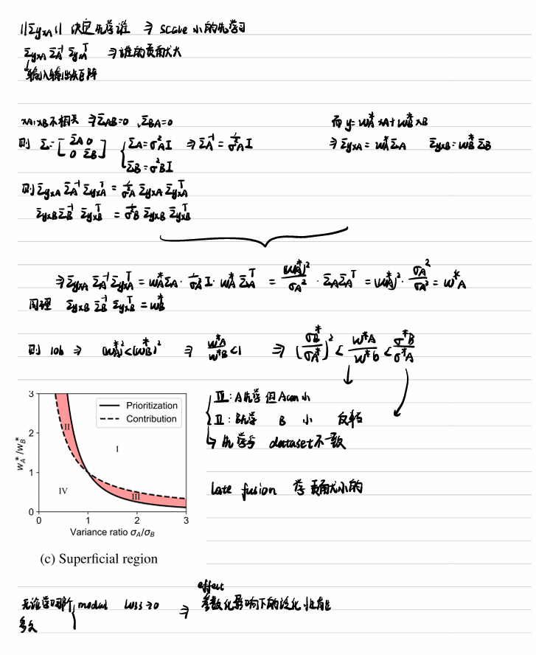
05
Appendix

Slide 26
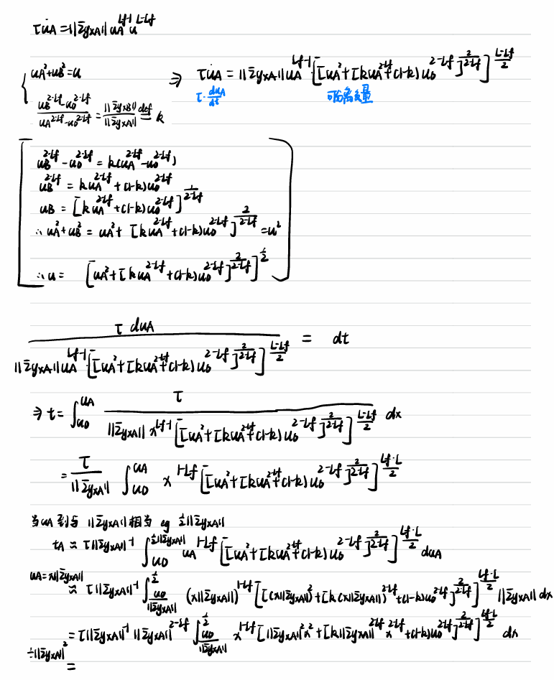
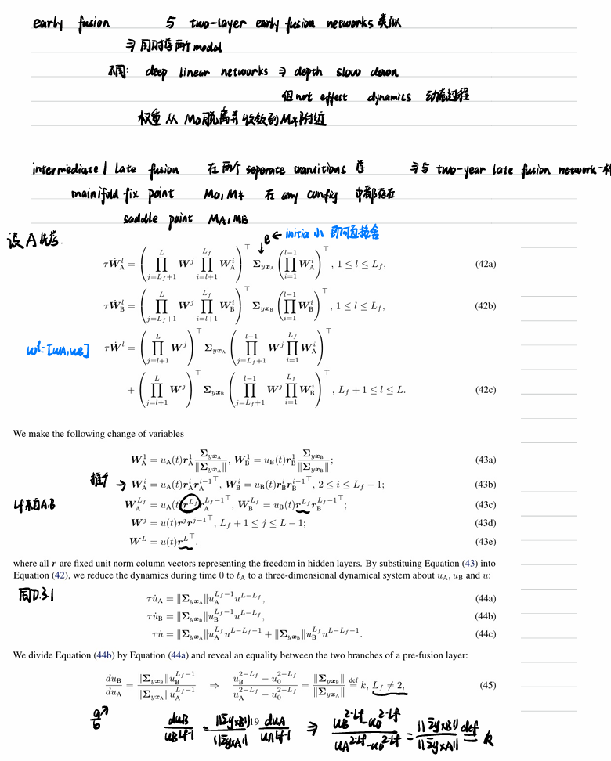
05
Appendix

Slide 27
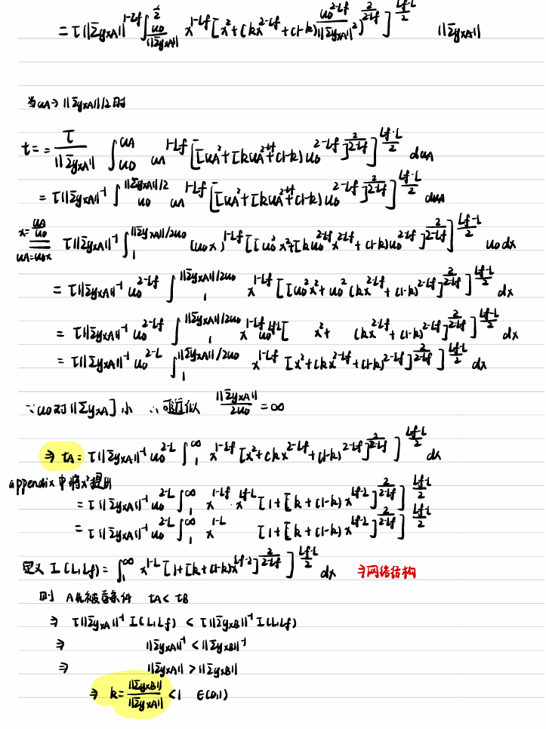
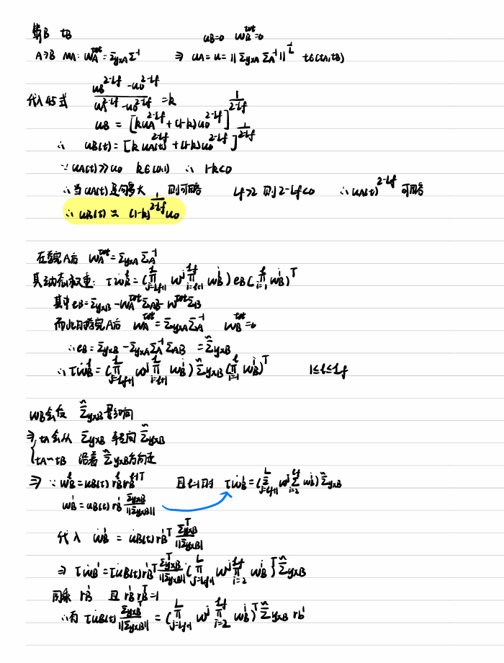
05
Appendix

Slide 28
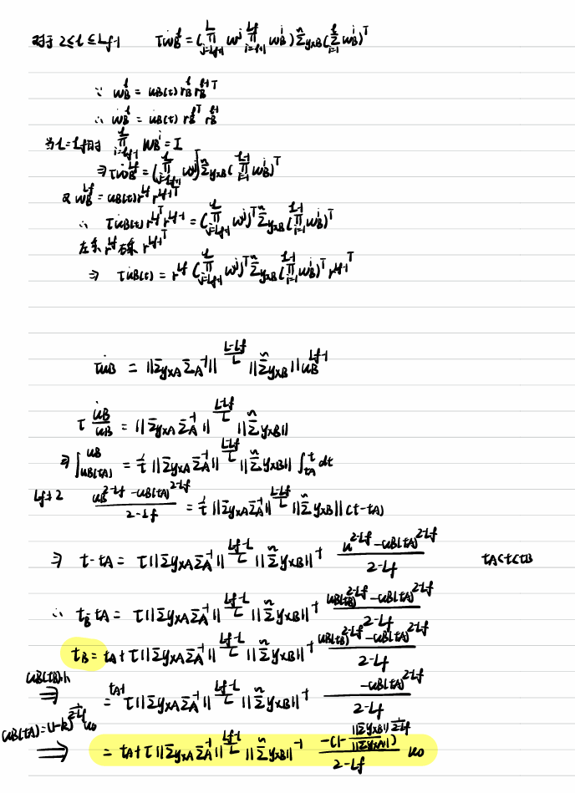
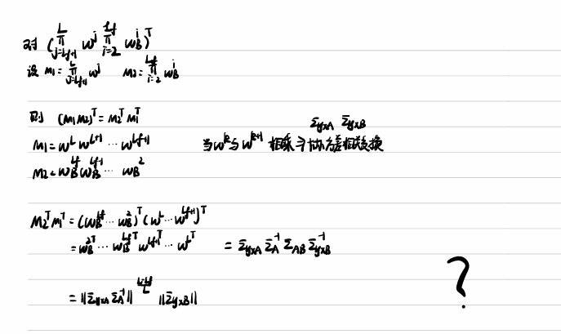
05
Appendix

Slide 29
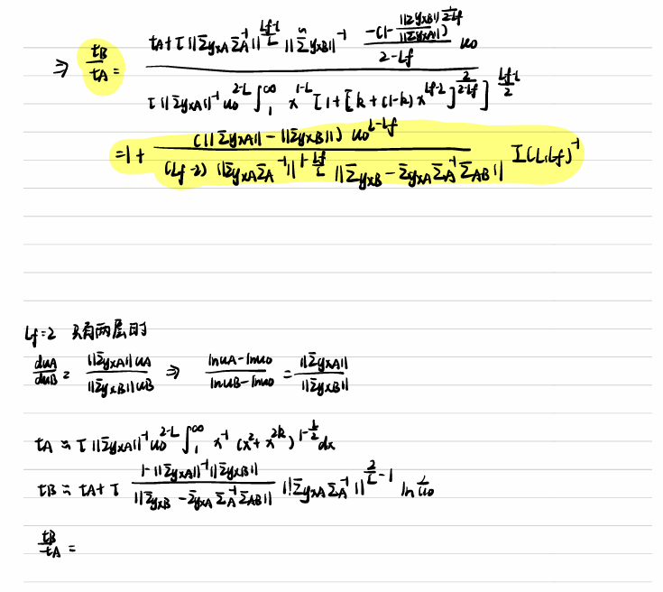
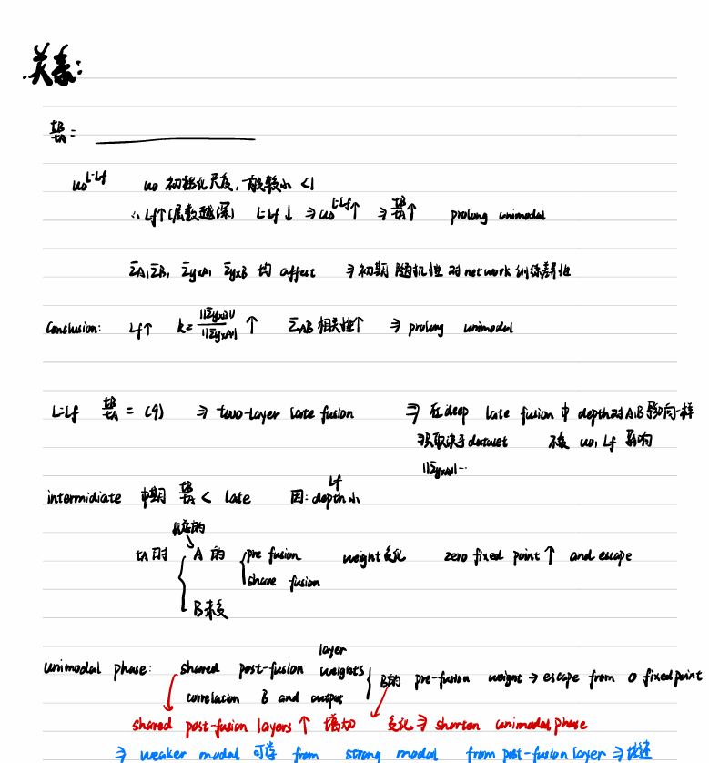
05
Appendix

